Slide 1
Battery

Slide 2
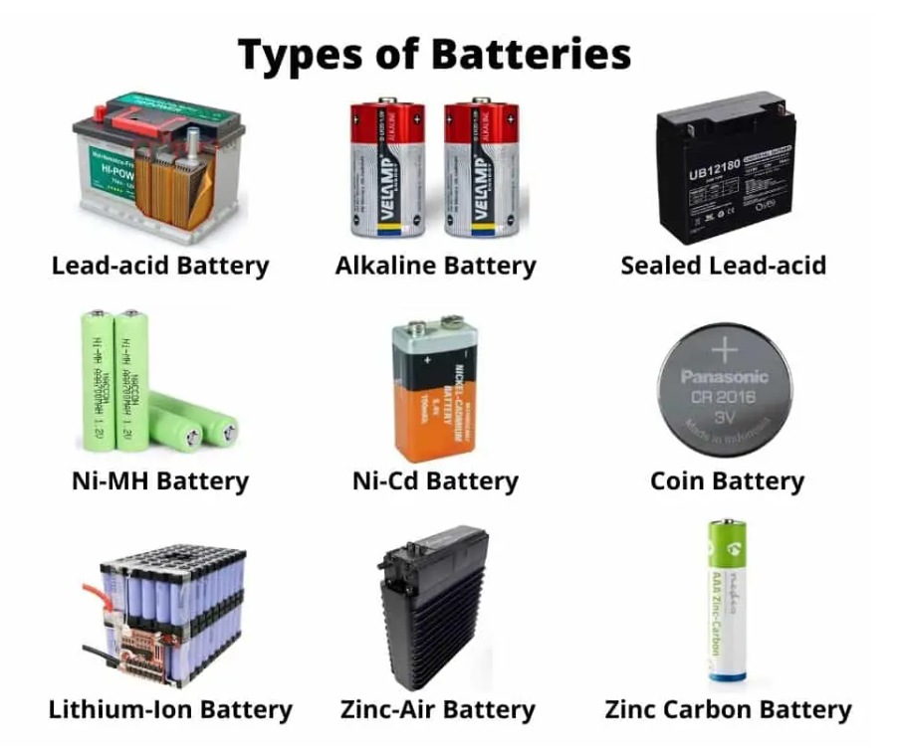

Slide 3
Why Study Batteries?

Slide 4
Automobile Applications

Slide 5
xEV
1. Hybrid Electric Vehicle (HEV) - Battery + at least one other source
2. Plug-ln Hybrid Electric Vehicle (PHEV) - Larger Battery than HEV
3. Extended-Range Electric Vehicle (E-REV) - Larger Battery than PHEV
4. Battery Electric Vehicle (BEV) - Only powered by Battery
Battery Packs that are "Large" "High Voltage", and "High Current"

Slide 6
Batteries can be classified into two major categories:
1. Primary Batteries
2. Secondary Batteries
The subcategories differ based on the following attributes:
1.Construction & Chemical Composition
2.Physical Attributes & Performance
3.Voltage, Amp-hour (energy) capacity, C-rating
4.Charging and Discharging characteristics

Slide 7
Battery Terminology

Slide 8
Cells
Batteries
Nominal Voltage and Capacity
C-Rates
Energy and Power
Cells connected in Series
Cells connected in Parallel
Load
Depth of Discharge (DOD)
Watts and Volt-Amps (VA)
State-of-Health (SoH)
State-of-Charge (SOC)
State-of-Function (SOF)

Slide 9
Cells
Cells are the smallest individual electrochemical unit,
They deliver a voltage that depends on the cell chemistry,
There are primary (single use) and secondary (rechargeable) cells,
A cell is different from a battery.

